Slide 1

Eyes and Smile Detection
Detect Eyes and Smiles with the Viola and Jones algorithm
Mutschlechner Gerrit, Jonas Fauner, Jonas Huber

Slide 2
Jonas Huber Part
…

Slide 3
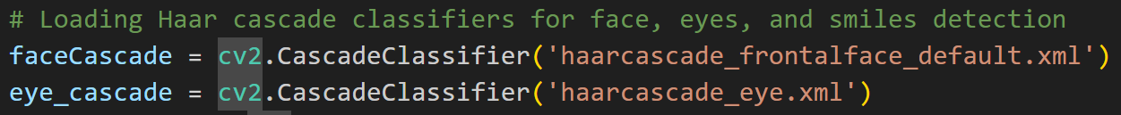
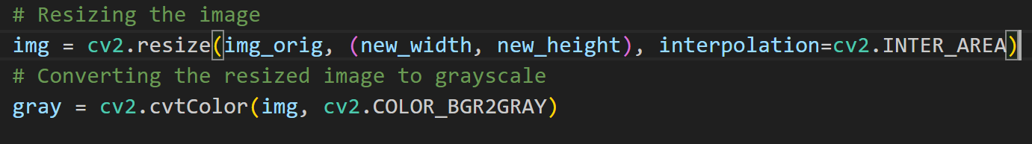
Code

Slide 4
‚detectMultiScale‘ Parameters
scaleFactor:
How much image size get reduced at each scale
Small: more detection
Large: reduce compution time
minNeighbors:
number of neighbors a candidate rectangle needs to have
Small: more detection
Large: fewer detections, better quaility

Slide 5
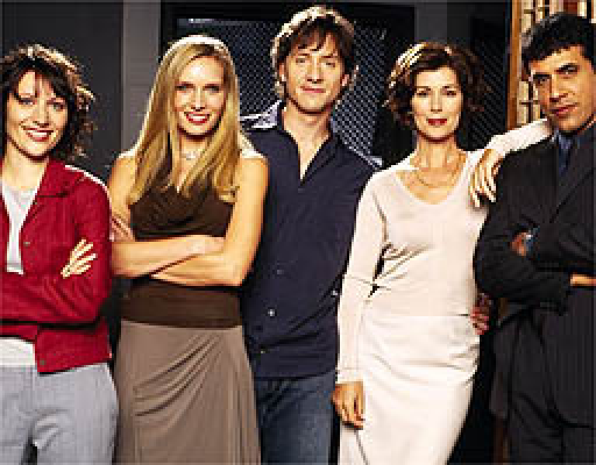
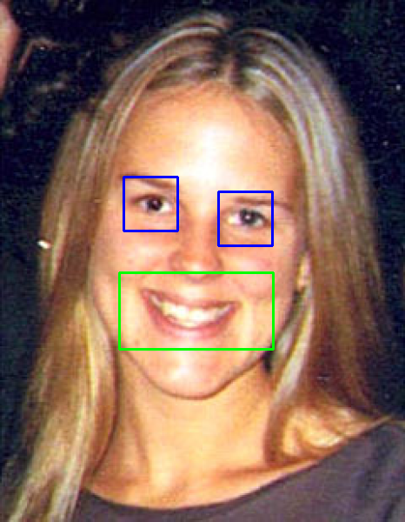
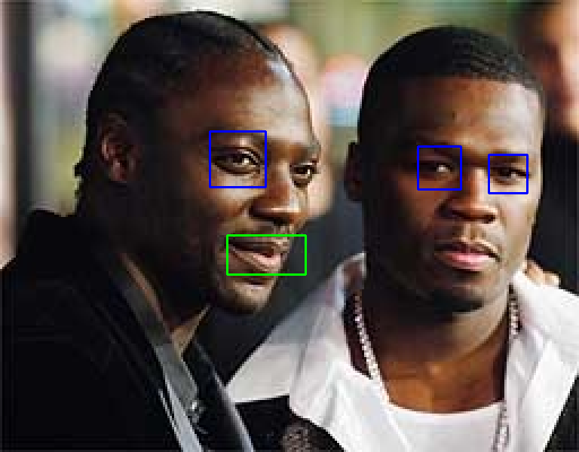
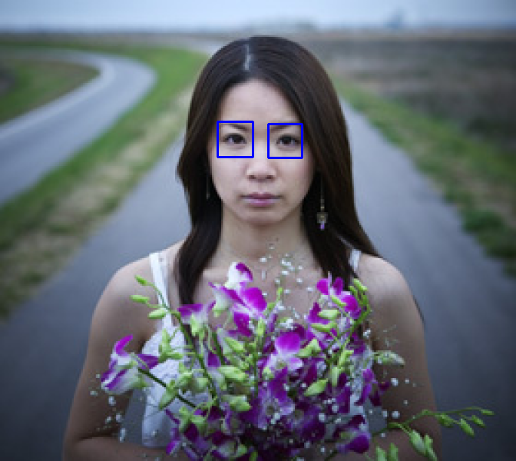
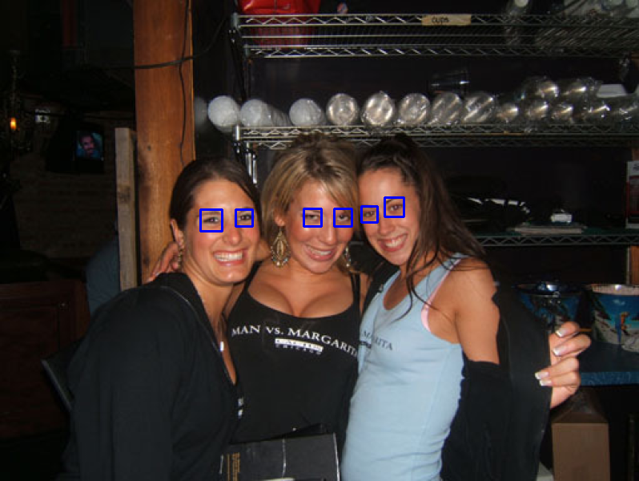
Eyes: scaleFactor=1.3, minNeighbors=3
Smiles: scaleFactor=1.7, minNeighbors=20

Slide 6

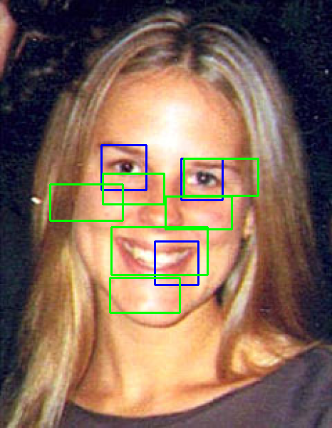
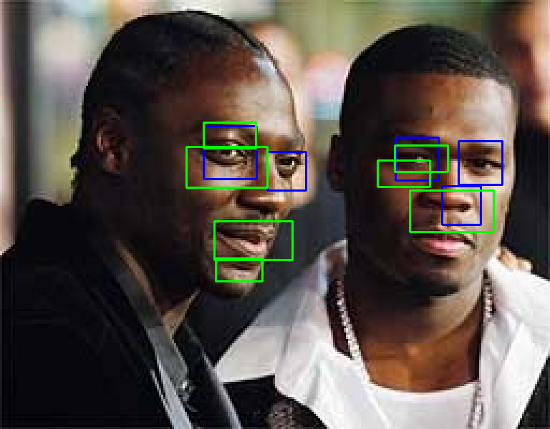
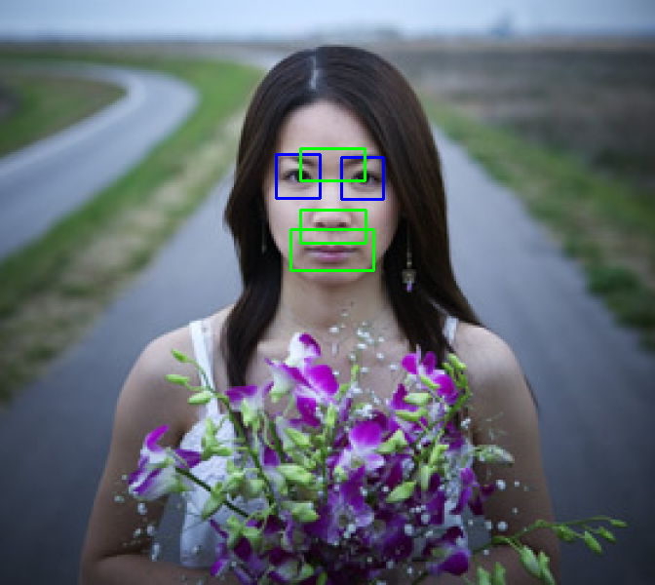

Eyes: scaleFactor=1.1, minNeighbors=3
Smiles: scaleFactor=1.1, minNeighbors=10

Slide 7

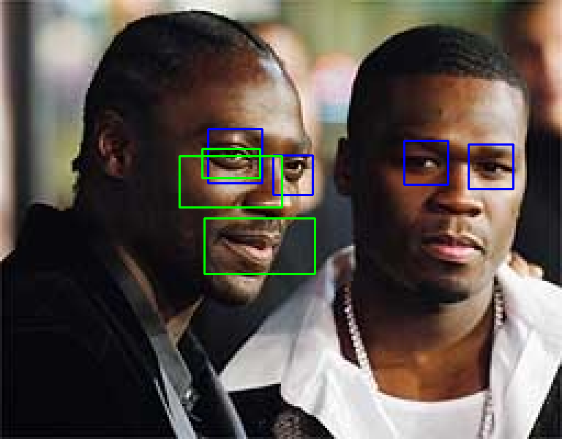
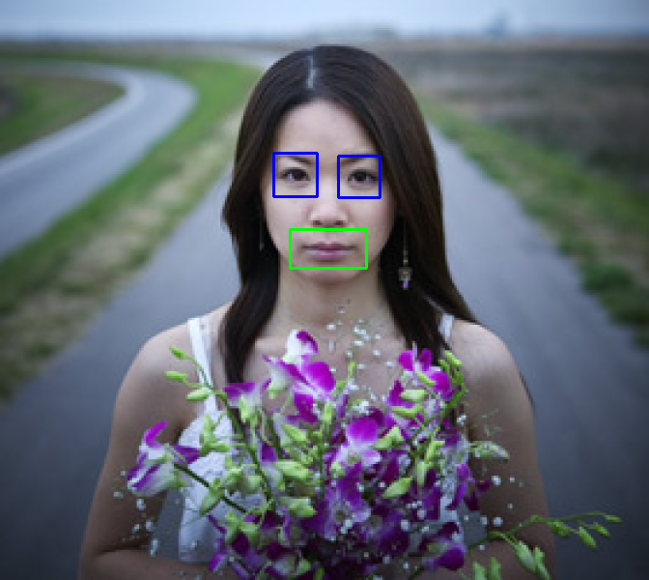
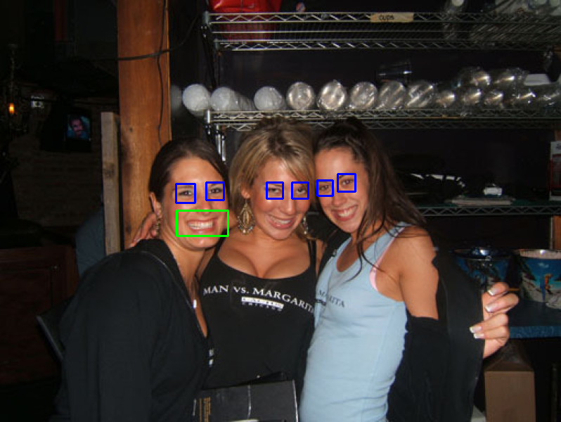
Eyes: scaleFactor=1.1, minNeighbors=7
Smiles: scaleFactor=1.3, minNeighbors=20

Slide 8


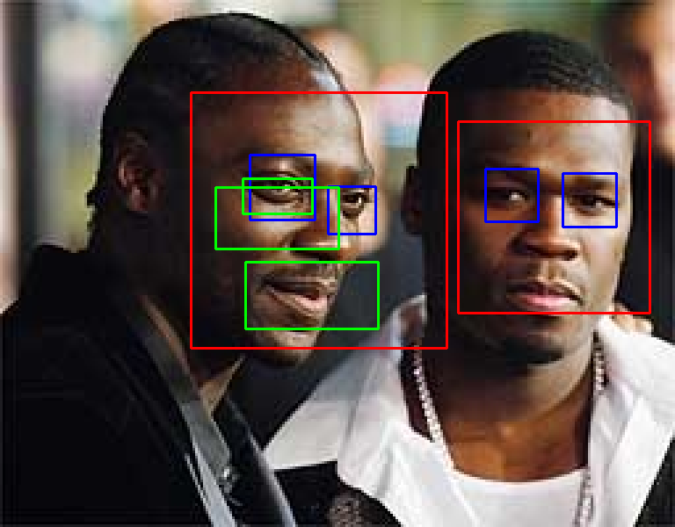


Face: scaleFactor=1.2, minNeighbors=5

Slide 9
Jonas Fauner Part
…

Slide 10
Thank you for your attention!

